Slide 2
Application of AI in Warehouse Scheduling Optimization Problems
Vangel Paronov, K11938626
Supervisors: Bianca Wiesmayr, Alois Zoitl

Slide 3
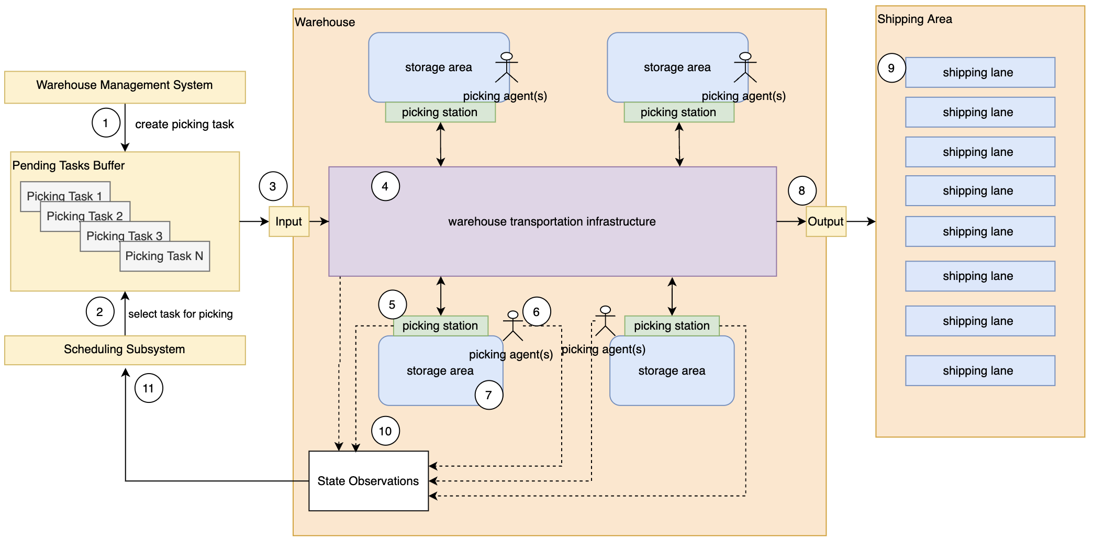
Problem definition (recap)

Slide 4
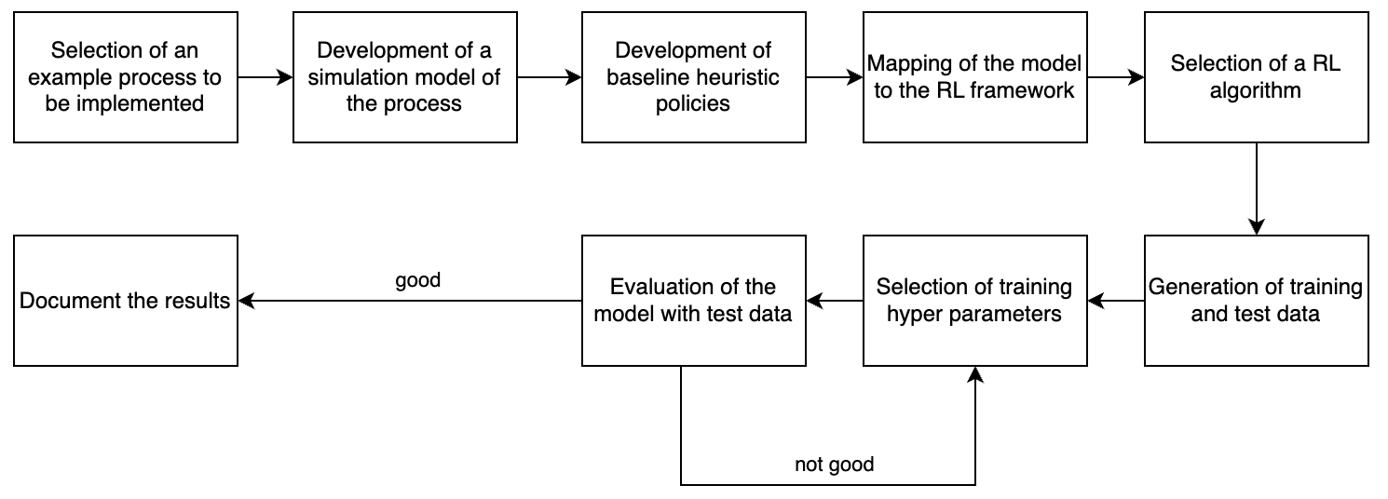
Project Steps

Slide 5
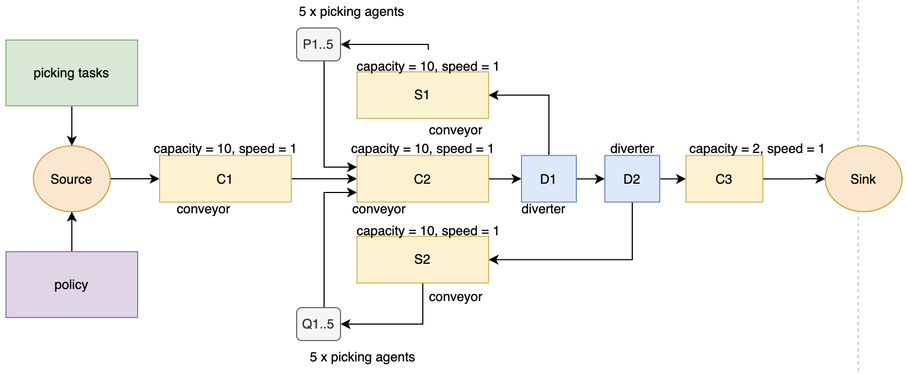
The Warehouse Structure

Slide 6
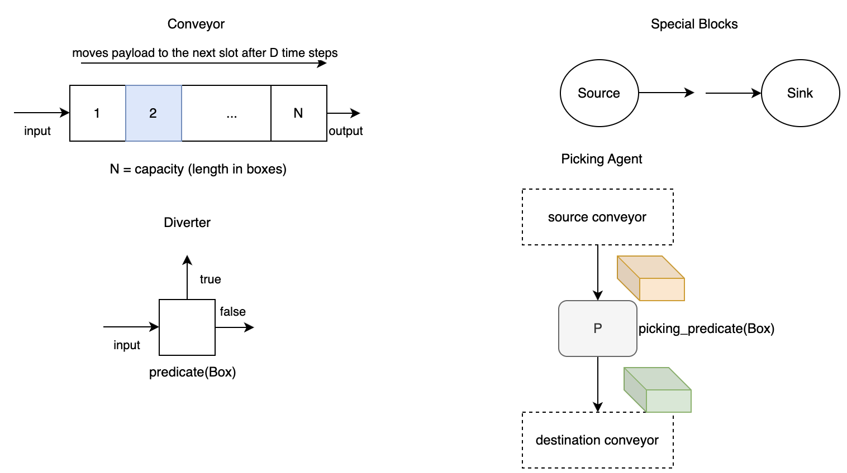
Simulation Primitives

Slide 7
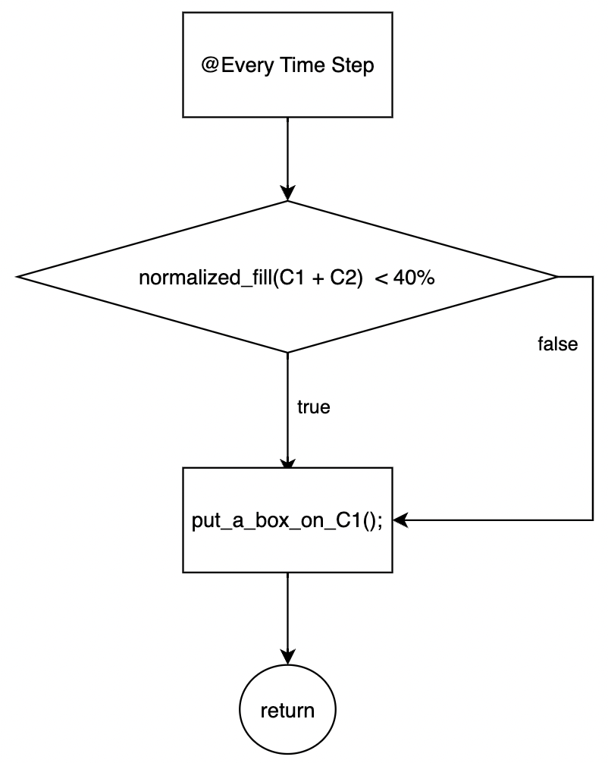
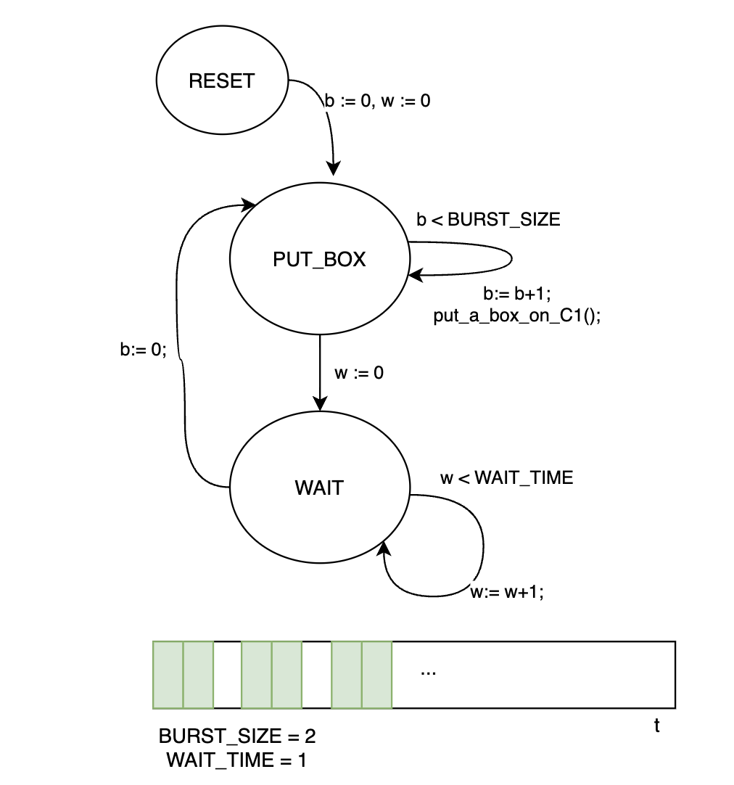
Baseline Heuristics
1) Timed Bursts
2) Check for Overfill

Slide 8
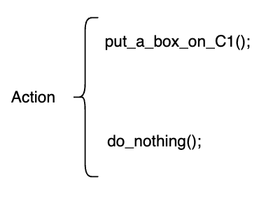
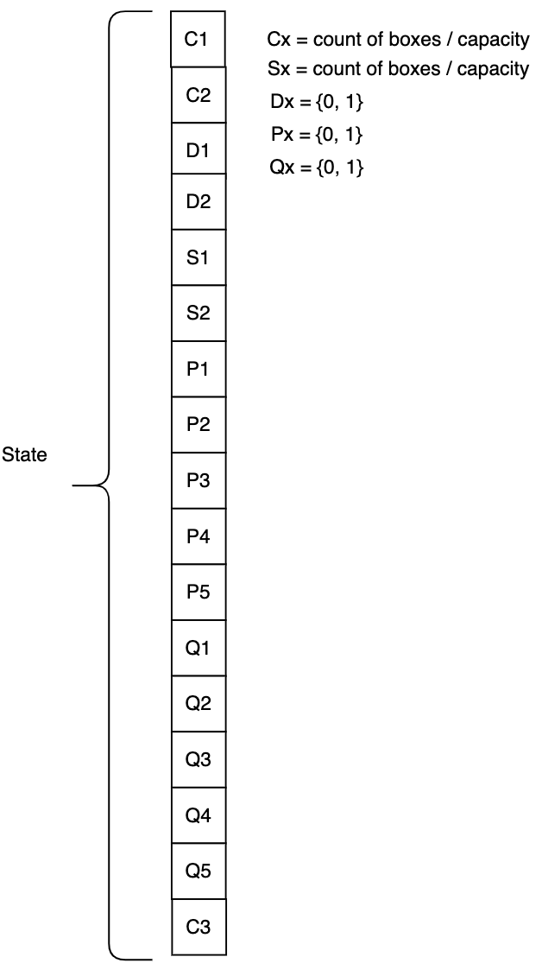
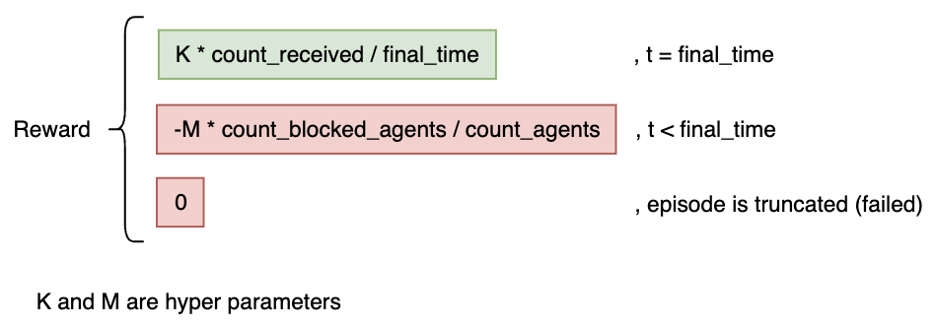
Mapping to the RL framework

Slide 9
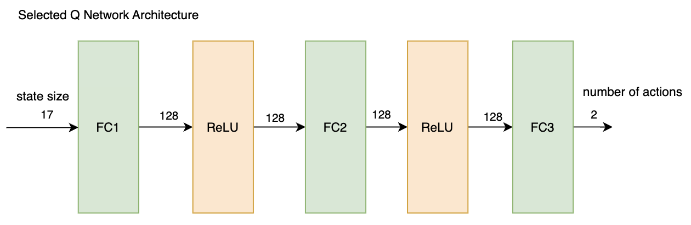
Selection of a RL algorithm
Deep Q-Learning Network (DQN)
Basic DQN
Double Q network
Dueling Network Archtiecure
Deep Deterministic Policy Gradient (DDPG)
Advantage Actor-Critic (A2C)
Trust Region Policy Gradient (TRPO)
Proximal Policy Optimization (PPO)
Actor Critic using Kronecker-Factored Trust Region (ACKTR)
Soft Actor-Critic (SAC)

Slide 10
Training and test data generation
The state is not dependent of the total count of boxes that are processed during the episode. For the selected architecture 100 boxes are enough to fill the conveyors.
For training 1000+ sets of 100 boxes with IID selected routing slips are generated.
For testing 1000+ sets of boxes 1 to 1000 boxes with IID selected routing slips are generated.
To improve the robustnest of the model, during the training the sets somethimes (on random) are sorted in respect to their routing slips.

Slide 11
Selection of training hyper parameters
# best results – speed / robustness
BATCH_SIZE = 256 # training batch size
GAMMA = 0.999999 # discount factor
EPS_START = 0.9 # random exploration prob start
EPS_END = 0.01 # random exploration prob end
EPS_DECAY = 10000 # epsilon decay rate
TAU = 0.005 # Q -> Q’ transfer rate
LR = 1e-4 # learning rate
num_episodes = 1000 # number of training episodes
memory = ReplayMemory(400000) # replay memory size

Slide 12
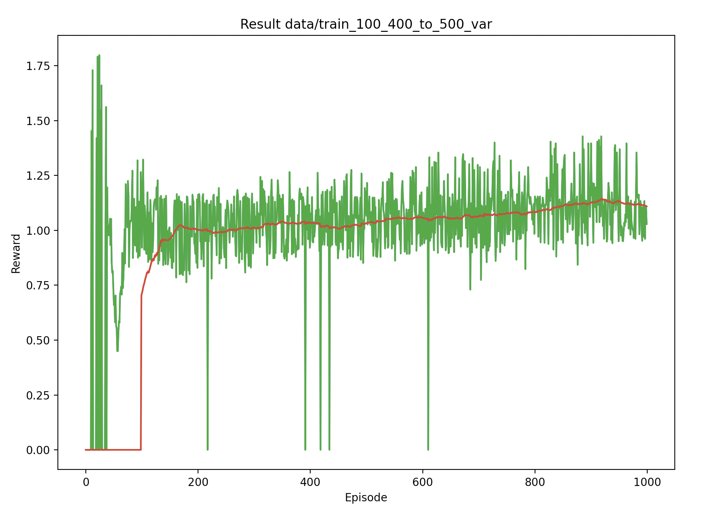
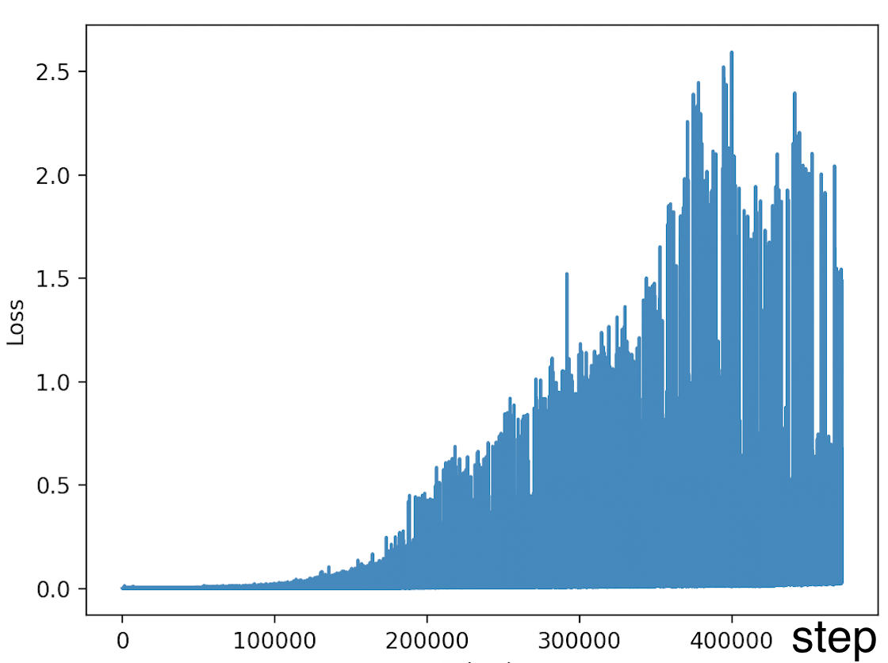
Performance evaluation (1)
Training Curve
Training Loss

Slide 13
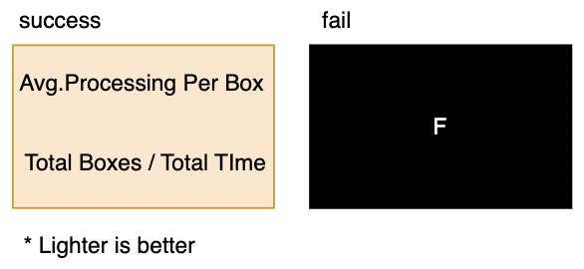
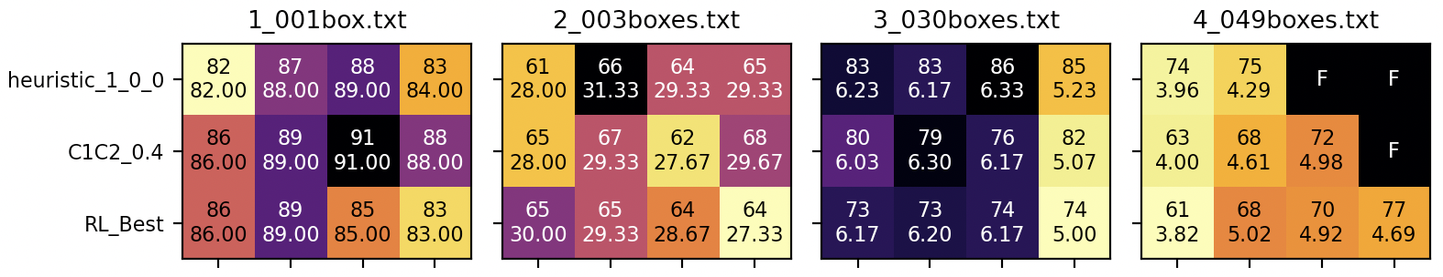
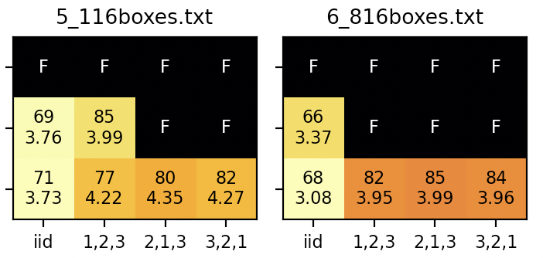
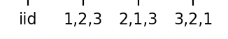
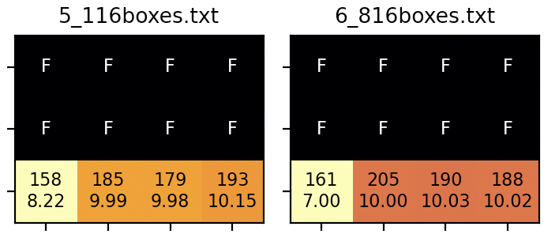
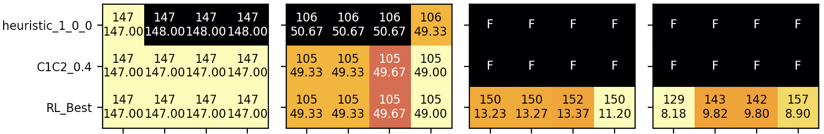
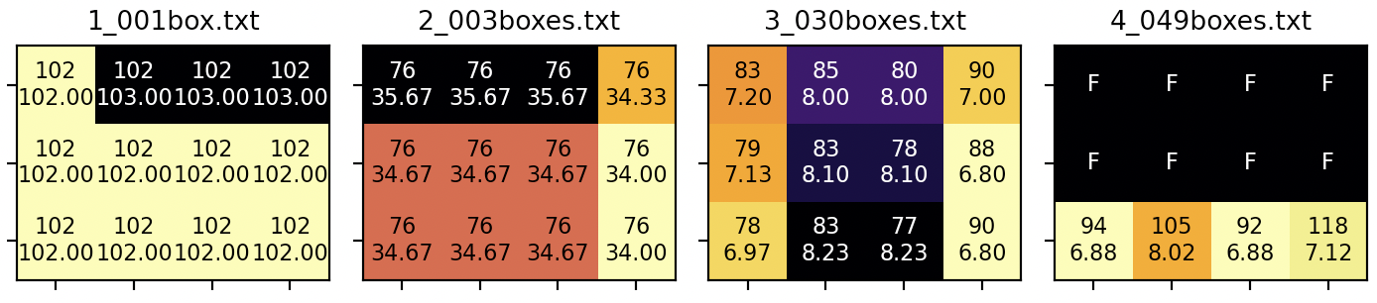
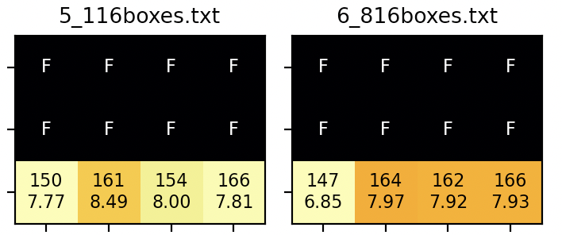
Performance evaluation (2)
Pick Time = uniform(16, 24)
Pick Time = uniform(40, 60)
Pick Time P pickers = 5, Pick Time Q pickers = 50

Slide 14
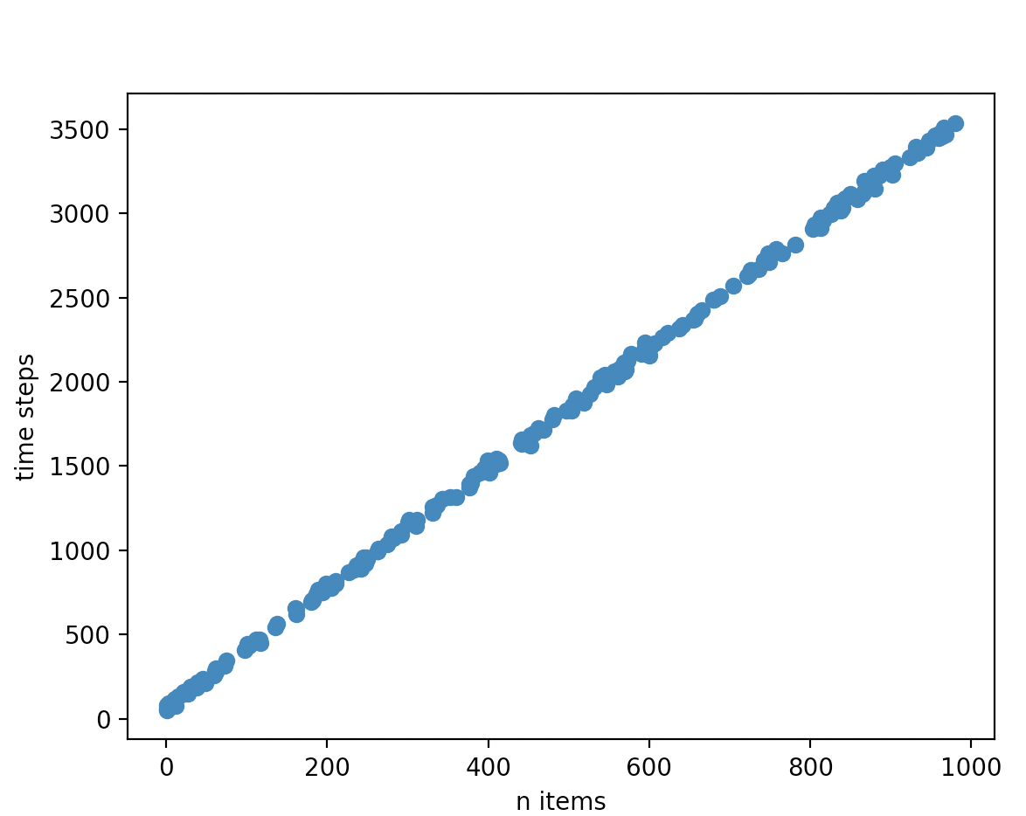
Performance evaluation (3)
Test set evaluation

Slide 15
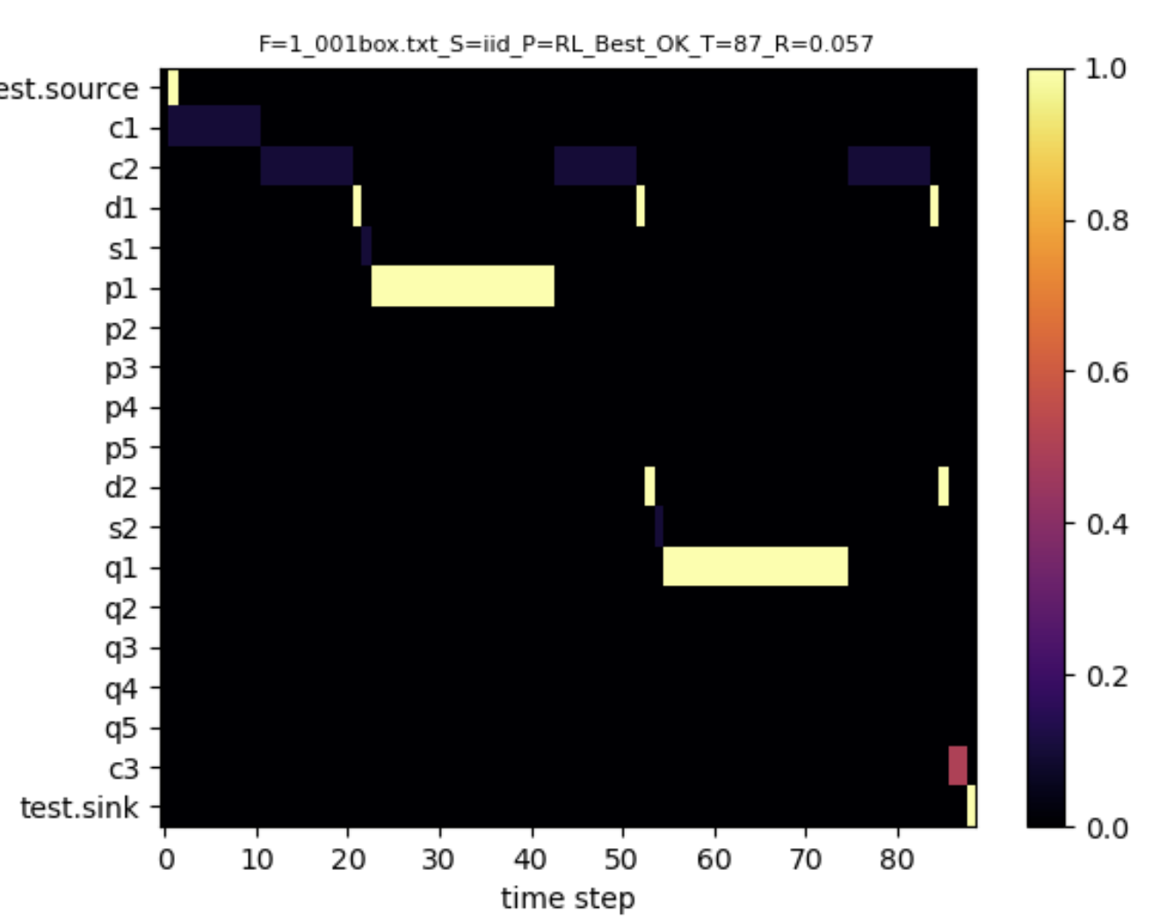
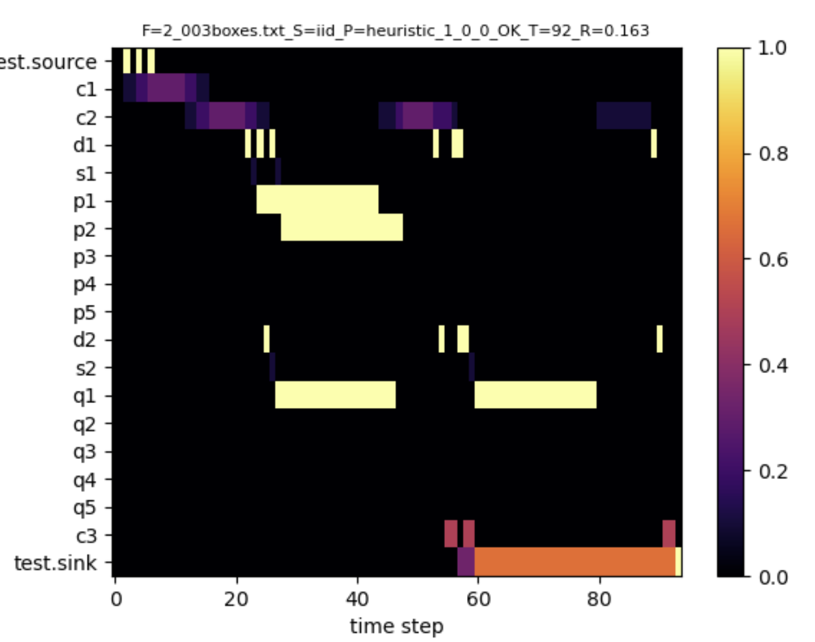


Performance evaluation (details)

Slide 16
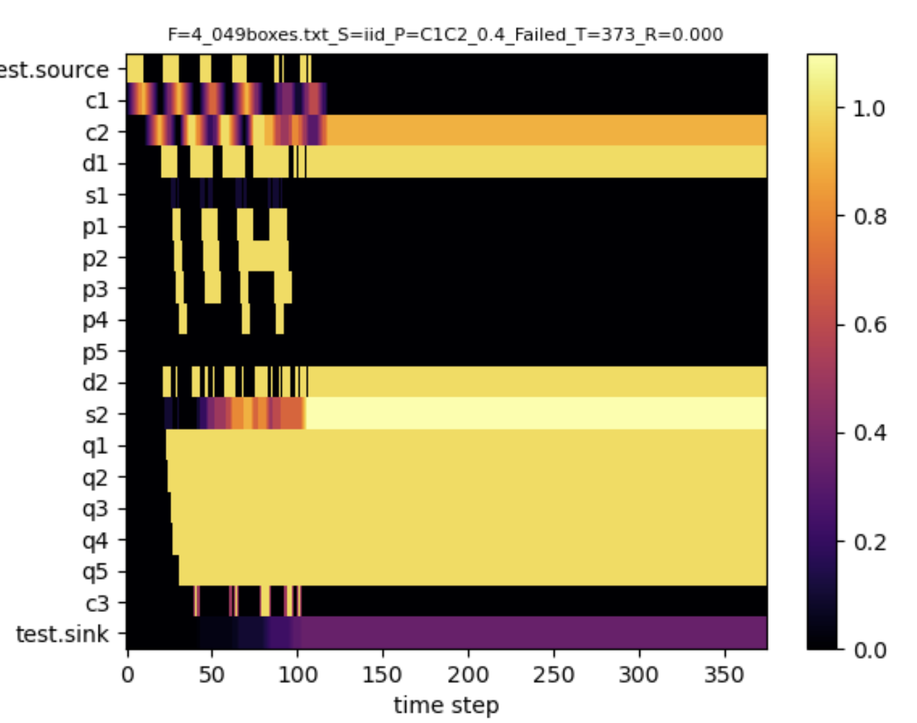
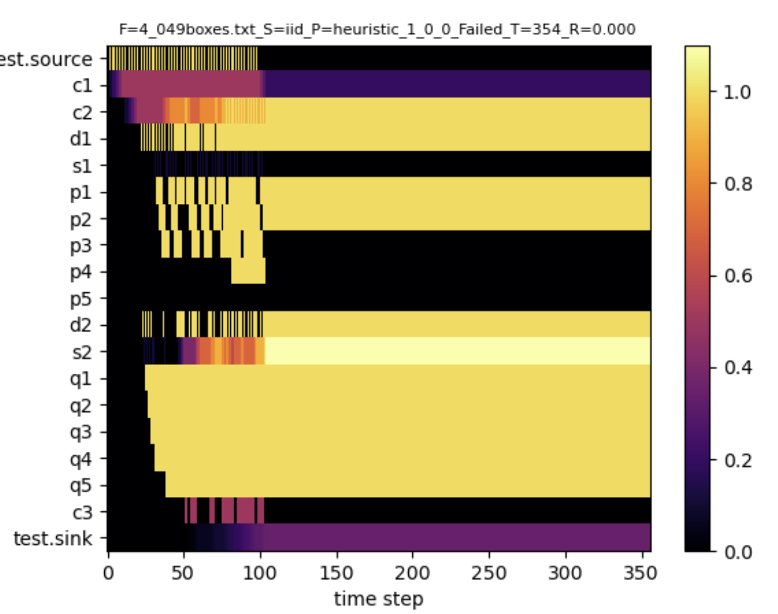
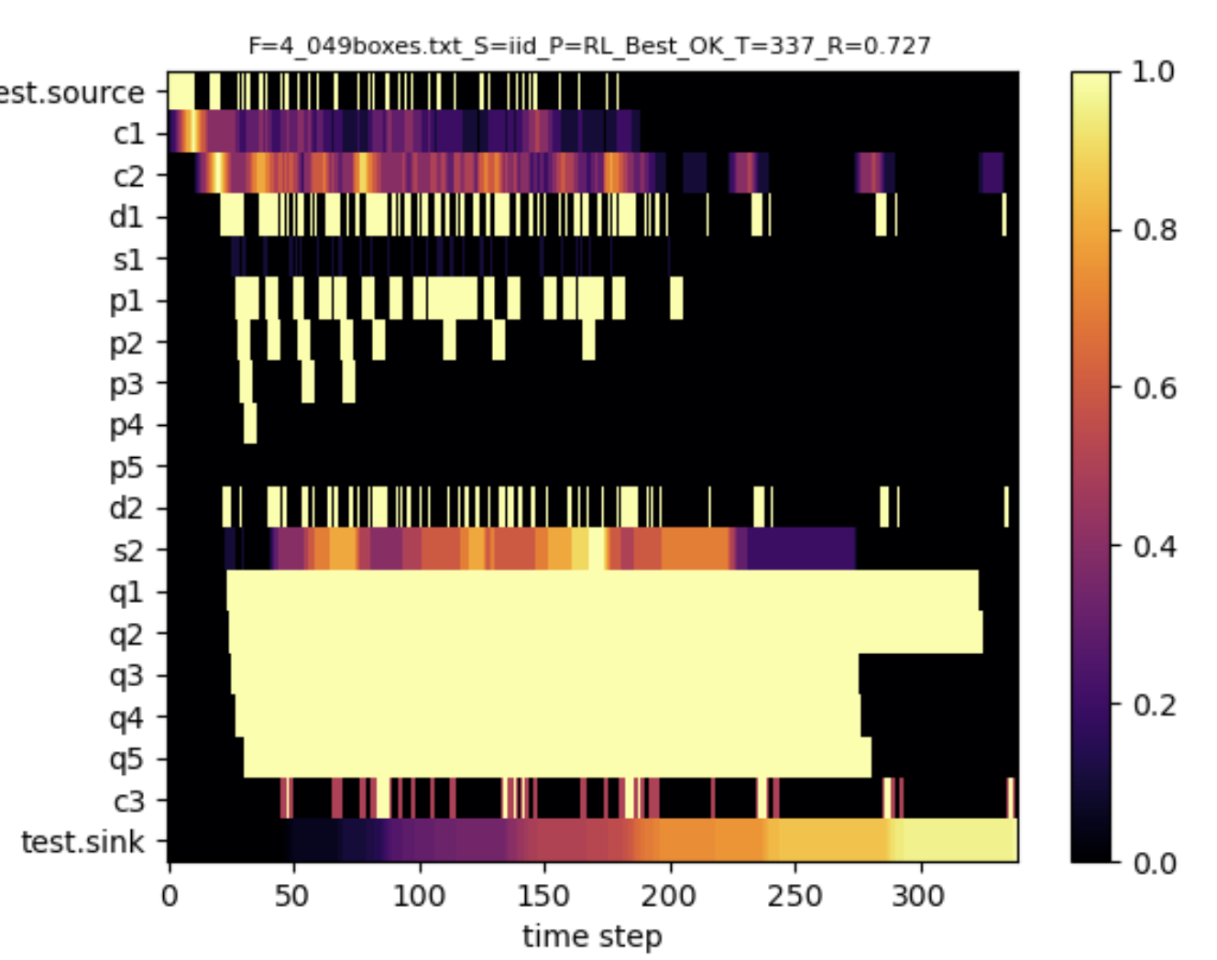
Performance evaluation (details)
Failed
Failed
Ok
Fixed heuristics are working only in a constrained environment, where the picker’s behaviour is known.
RL model is robust – solves the problem even when the behaviour of the pickers is different than the training

Slide 17
Thank You For Your Attention

